Slide 1


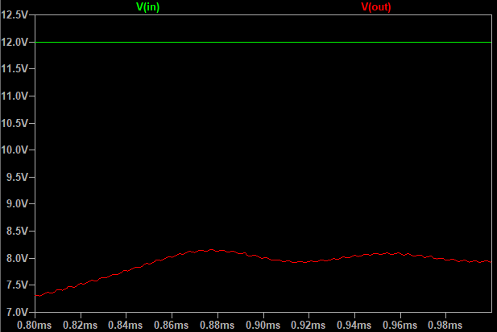
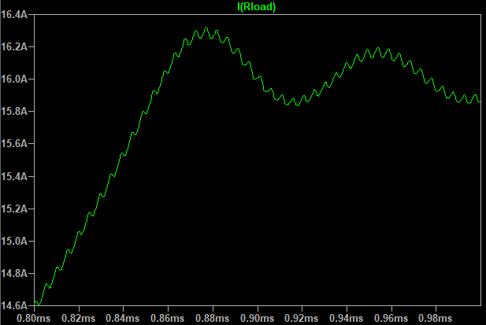
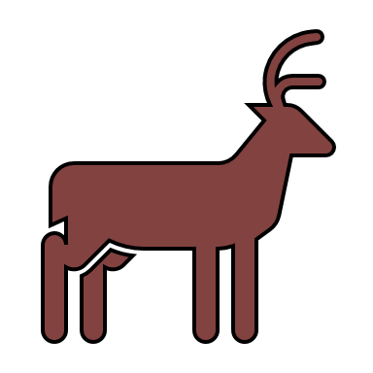



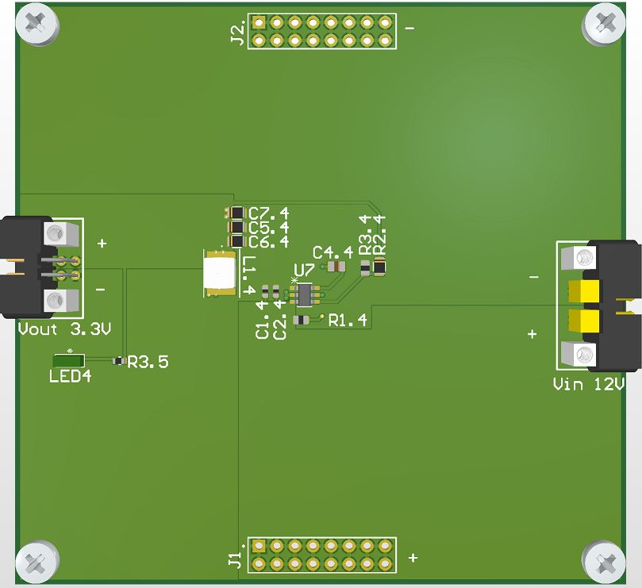
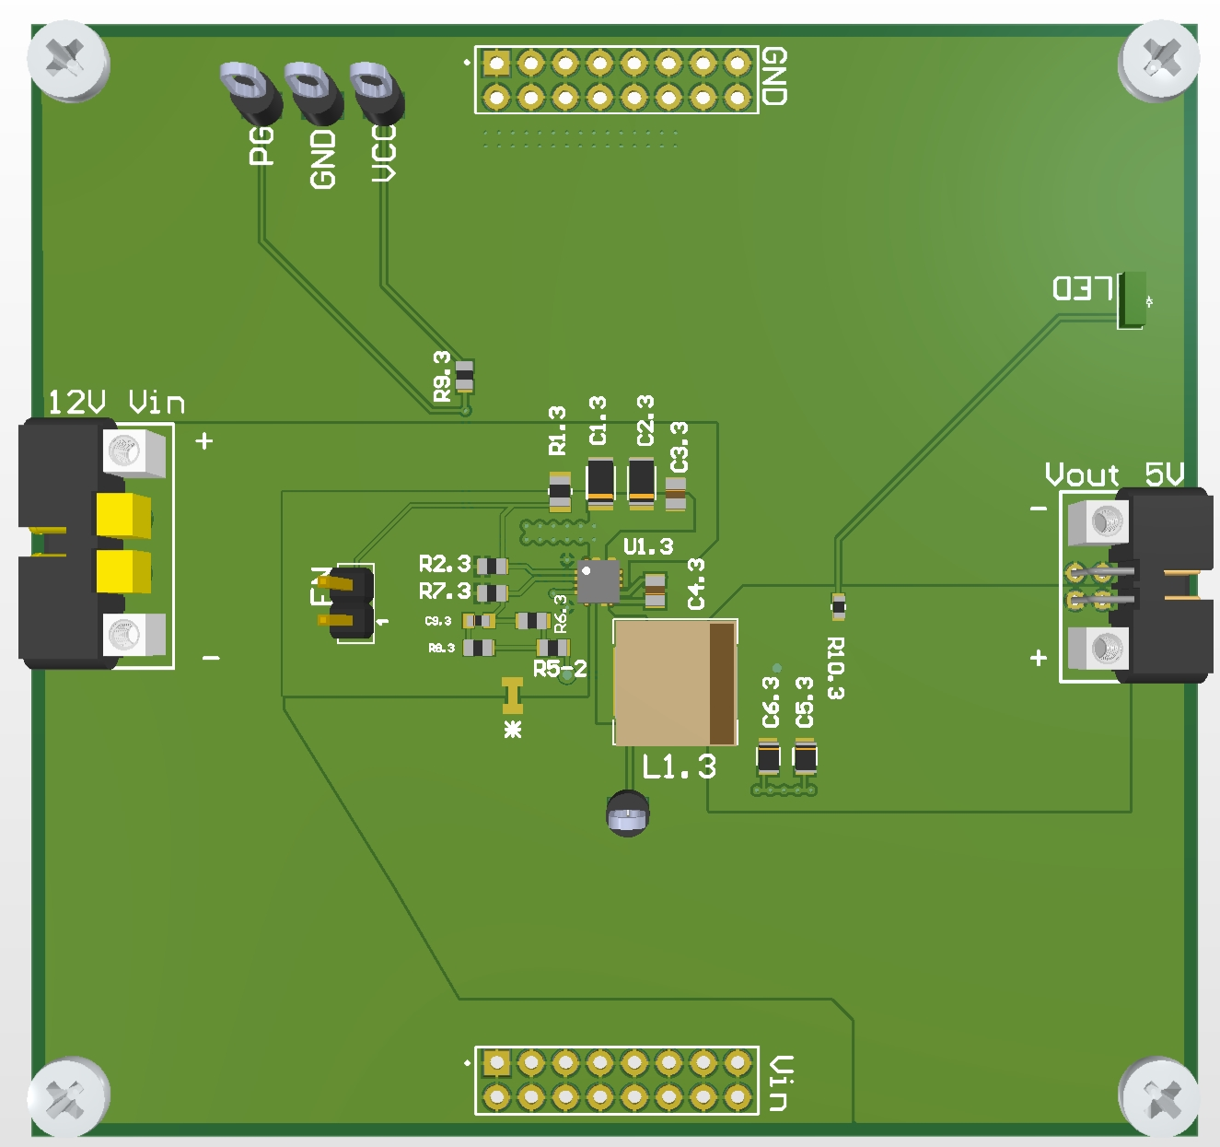

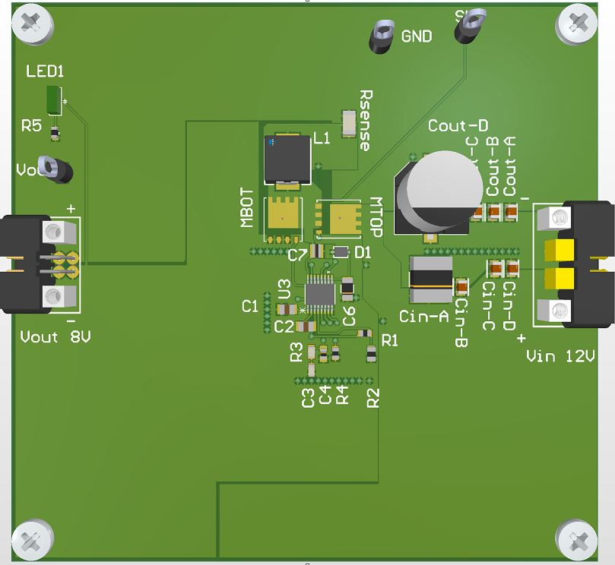
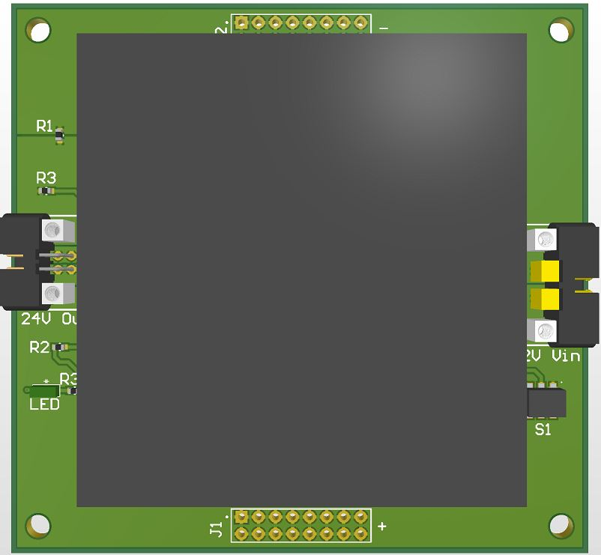
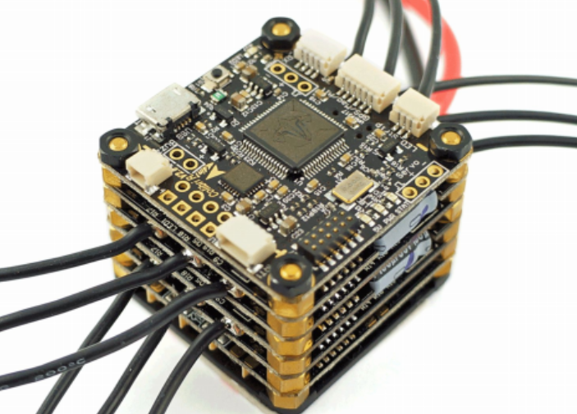
PCB Design, Assembly, and Manufacturing
of a Power Distribution Board
ECE 499, Group 5
Kyle Jarvis (V00730008), Bryce Gammon (V00709534), Sean Schocat (V00925804), and Dai Tran (V00928014)
Introduction
Methodology and Design
Simulation Results
UVic's Centre for Aerospace Research (CfAR) has an unmanned aircraft that uses a PDB to power its various systems
This PDB takes a 12V input and has four converter circuits that generate 3.3V, 5V, 8V, and 24V outputs
The current implementation of this PDB has limitations and issues CfAR would like to address
Overall goal: Design a modular PDB to replace the existing PDB system
A modular design achieves desired voltages while allowing additional PCBs in the future
Allow any board to serve as the input, route from this board to the rest of the system
Allow stacking of boards so subsets of the PDB system can be used as desired
Reduce number of layers from four to two if possible to reduce costs
Place components as close to ICs as possible to minimize trace length, signal noise, and allow for large ground planes
Validate new 8V design with LTspice simulation
An LTspice simulation confirms that the 8V converter outputs 8V and 15A current with 12 V input
Buck & Boost Conversion
Results – Final PCB Designs
Conclusion
Buck Conversion
Chops high voltage to a lower average and creates a lower voltage output
Boost Conversion
Rapidly switches an inductor to utilize its tendency to resist voltage change to pull a lower voltage to a higher voltage
3.3V buck (left) and 5V buck (right) converters
Working design that has been migrated to single PCB's
Two-layer design
Our redesign addresses CfARs needs and provides modularity while reducing overall costs.
Future Work
Add support for cooling (e.g. using fans)
Add overvoltage protection and reverse polarity protection
Reduce 3.3V and 5V board sizes
Design Objectives
Incorporate modularity by splitting the all-in-one PDB into several individual PCBs
Minimize the cost of the design as much as possible
Replace the ICs on the 8V and 24V converters and verify the new designs work
Generate fabrication files for all four PCBs
References
8V buck (left) and 24V boost (right) converters
New design created for the 8V and validated through simulation
24V single unit converter used, reducing circuit overhead
Two-layer design
[1] "Quad Questions," Quad Questions, 2020.
[Online]. Available: https://quadquestions.com/product/tbs-powercube/ [Accessed 27- Mar- 2021].
Acknowledgements
We would like to thank everyone who contributed to the success of this project. We would like to thank our project supervisor Babak Manouchehrinia, and project co-supervisor Kieran Warren for their guidance and support. We would also like to thank our friends and family who supported us during this semester of online learning.
[1] Example of a stacked PCB system

